Slide 1
Mobile Application Development

Slide 2
What is Mobile App ?
Definition: A software program designed to run on a mobile device, such as a smartphone or tablet.
Platforms: iOS (Apple), Android (Google), and others (e.g., Windows Mobile).

Slide 3
Types Of Apps
Native – Specific platform
(Android or iOS )( Java/Kotlin for Android, Swift for iOS).
Web Apps – Browser
(HTML, CSS, JavaScript).
Hybrid – cross-platform
(e.g., using tools like Kotlin).

Slide 4
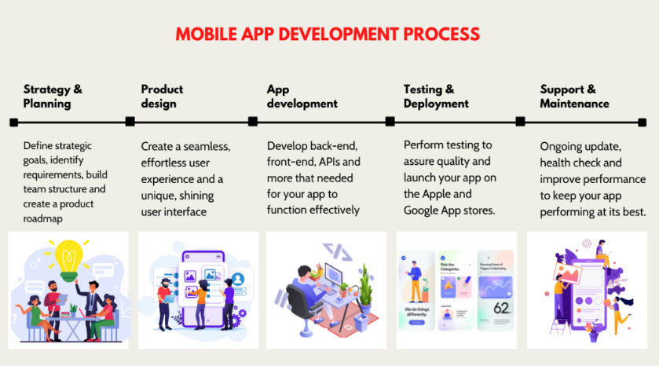
Mobile App Development Lifecycle

Slide 5
Challenges in Mobile App Development
Fragmentation and Cross-Platform: Different devices, screen sizes, and operating systems(specific to iOS or Android).
Security Concerns: Protecting user data and securing app functionalities.

Slide 6
Contd..
Scalability and Maintenance:
Growth Challenges - As user numbers grow, maintaining app performance, handling larger data volumes.
Frequent Updates: Regular updates are necessary for new features, security patches, and bug fixes.

Slide 7
Android Development
History
Introduction​
Features of Android
Android Versions
Android Architecture

Slide 8
History
Andy Rubin founded Android Incorporation in Palo Alto, California, United States in October, 2003.
In 17th August 2005, Google acquired android Incorporation.
The key employees of Android Incorporation are Andy Rubin, Rich Miner, Chris White and Nick Sears.

Slide 9
Introduction
What is Android ?
Android is open-source mobile operating system based on a modified version of the Linux kernel.
Developed by Google primarily for mobile devices like smartphones and tablets.

Slide 10
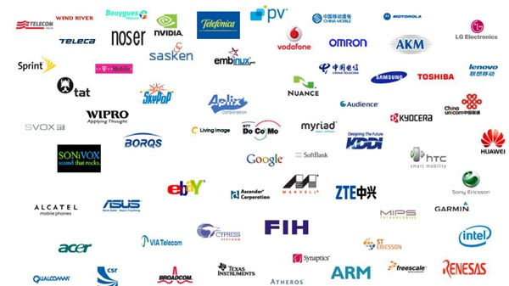
Open Handset Alliance(OHA)

Slide 11
Cont.
It has been developed by a consortium of developers known as the Open Handset Alliance(OHA),but its most widely used version is primarily developed by Google.
Android 15 is the latest version of Android, and it was released on September 3, 2024.

Slide 12
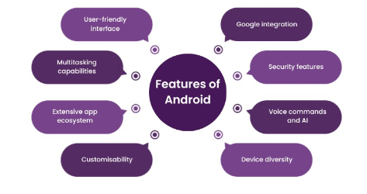
Features

Slide 13
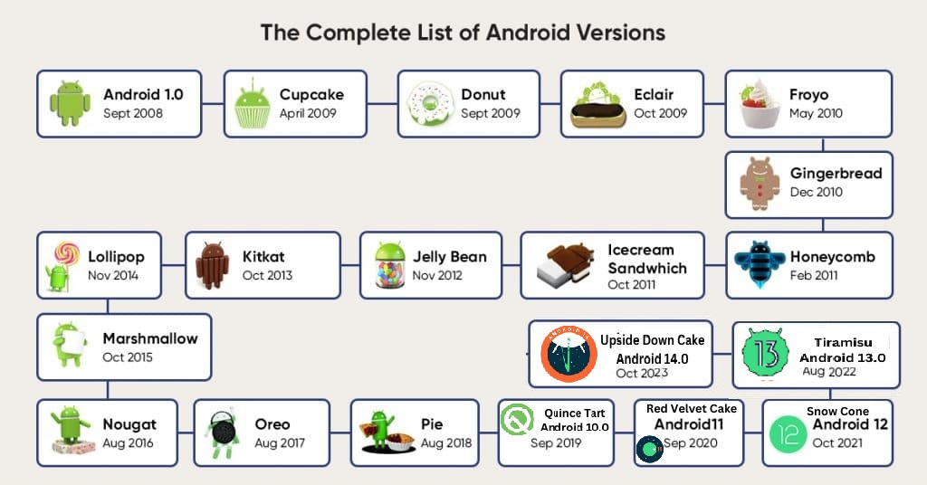
Versions

Slide 14
2009
Android 1.5 Cupcake (2009) - Added an on-screen keyboard and support for third-party apps.
2009
Android 1.6 Donut (2009) - Introduced improvements like support for CDMA networks and an updated user interface.
2009–2010
Android 2.0-2.1 Eclair (2009-2010) - Added features like improved Google Maps, and a revamped interface.
2010
Android 2.2 Froyo (2010) - Introduced performance improvements and features like Wi-Fi hotspot support.
2010
Android 2.3 Gingerbread (2010) - Brought a new user interface and enhanced support for gaming.
2020
Android 11 (2020) - Improved conversation management, notification bubbles, and one-time permissions.
2021
Android 12 (2021) - Featured a new design language called Material You and more customization options.
2022
Android 13 (2022) - Continued with design improvements and added features for better tablet and foldable device support.
2023
Android 14 (2023) - Focused on performance and user experience enhancements.

Slide 15
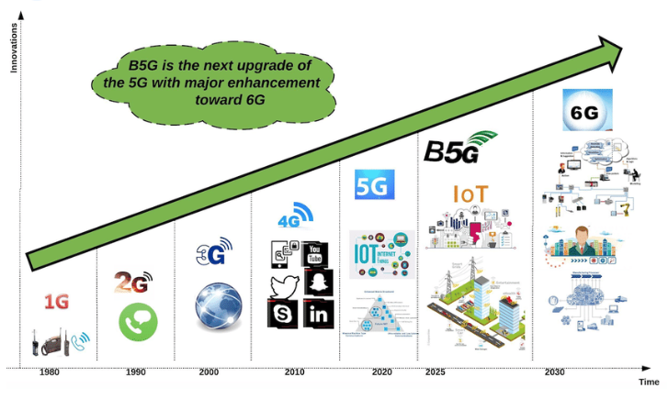
Generations

Slide 16
Evolution of android mobiles
1. First Generation (1G) – Analog Cellular (1980s)
Technology: Analog
Key Features:
Introduced the first mobile phones (voice-only communication).
Analog signals with poor sound quality and security.
Limited coverage and expensive.
Large, bulky mobile phones (e.g., Motorola DynaTAC).

Slide 17
Contd.
2. Second Generation (2G)- Digital Cellular(1990s)
Small phones, more Affordable, battery-efficient.
Sound quality and secure connections.
SMS and MMS
Key Features:
Technology: Digital

Slide 18
Contd.
3.Third Generation (3G)- Mobile Internet (2000s)
UMTS(Universal Mobile Telecommunications System)-based on GSM(Global System for Mobile communications voices) and CDMA(Code Division Multiple Access).
Sound quality and secure connections.
Mobile Internet, Browsing and Video streaming
Key Features:
Technology: Digital with packed-switched data

Slide 19
Contd.
4. Fourth Generation (4G)- Mobile Broadband(2010s)
Video Conferencing
Key Features:
Technology: All – IP Network, LTE

Slide 20
Contd.
5. Fifth Generation (5G)- Ultra Fast , Low- Latency Connectivity 2020s
AR, VR, high – performance cloud computing
Key Features:
Technology: MIMO
Advanced technologies like IoT, autonomous vehicles.

Slide 21
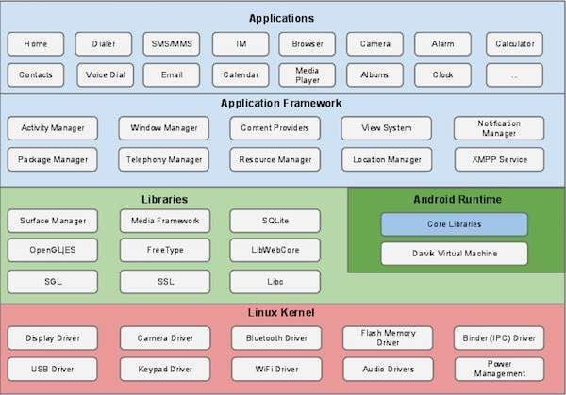
Architecture

Slide 22
Linux Kernel
Foundation of Android OS: Android is built on top of the Linux kernel, which provides basic system functionalities like process management, memory management, and device hardware interaction.
Drivers: It includes hardware drivers such as display, camera, Bluetooth, and more, enabling the OS to interact with the underlying hardware.

Slide 23
Native Libraries and Android Runtime
Native Libraries: These are C/C++ libraries used by various components of the Android system.
Examples include:
Surface Manager: Handles display subsystems and manages windows and surfaces.
SQLite: Provides relational database support.
OpenGL/ES: 2D and 3D graphics library.
WebKit: Browser engine used to display web content.

Slide 24
Contd..
Libc: Standard C system library.
Android Runtime (ART): Replaces the older Dalvik Virtual Machine (DVM). It executes and manages the running of Android apps, translating the compiled Java bytecode into native machine code. ART provides better performance, memory management, and debugging capabilities.

Slide 25
Application Framework
Services and Managers: Provides higher-level services and classes used by developers to create Android apps.
Core components include:
Activity Manager: Manages the lifecycle and navigation of apps.
Content Providers: Facilitates data exchange between applications.

Slide 26
Contd..
Resource Manager: Handles resources like strings, layouts, and drawable files.
Location Manager: Provides location services.
Package Manager: Manages the installation, updating, and uninstalling of apps.
Notification Manager: Controls notifications and alert systems.

Slide 27
Applications
User-Level Apps: This is the topmost layer of Android architecture. Applications like SMS, browser, contacts, and custom apps developed by third-party developers run at this layer. These apps interact with the application framework and underlying layers.

Slide 28


